Slide 1
Audio Classification Project Using Deep Learning
Speech processing

Slide 2
Classification Phases:
Data Acquisition
Exploratory Data Analysis(EDA)
Preprocessing
Modeling

Slide 3
Data
Acquisition
URBAN SOUND DATASET

Slide 4
Data Acquisition
We Use URBAN SOUND DATASETS
https://urbansounddataset.weebly.com/
This dataset contains 8732 labeled sound excerpts (<=4s) of urban sounds from 10 classes: air_conditioner, car_horn, children_playing, dog_bark, drilling, enginge_idling, gun_shot, jackhammer, siren, and street_music. The classes are drawn from the urban sound taxonomy.

Slide 5

Data Acquisition
All excerpts are taken from field recordings uploaded to www.freesound.org. The files are pre-sorted into ten folds (folders named fold1-fold10) to help in the reproduction of and comparison with the automatic classification results reported in the article above.
In addition to the sound excerpts, a CSV file containing metadata about each excerpt is also provided.
Some examples of urban sounds
Car horn sound Dog bark sound

Slide 6

Librosa
In our audio classification project we will use librosa for audio analysis.
Librosa is a python package for music and audio analysis. It provides the building blocks necessary to create music information retrieval systems.

Slide 7
Exploratory Data
Analysis
(EDA)

Slide 8
Exploratory Data Analysis(EDA)
EDA Shows us how does a sound wave look like .
In This Phase we will Display audio files in the form of signals.
To figure out the audio into signals we will use matplotlib library that is a comprehensive library for creating static, animated, and interactive visualizations in Python. and we also use ipython.display to display some graphs.

Slide 9
Exploratory Data Analysis(EDA)
Audio Feature Extraction:
At first we will extract features from the audio.
As a form of a wave, sound/audio signal has the generic properties of:
Frequency: occurrences of vibrations per unit of time
Amplitude: maximum displacement or distance moved by a point on a wave measured from its equilibrium position; impacting the sound intensity
Speed of sound: distance traveled per unit of time by a soundwave
.

Slide 10
Exploratory Data Analysis(EDA)
Below are some generic features that can be extracted:
Channels: number of channels; 1 for mono, 2 for stereo audio
Sample width: number of bytes per sample; 1 means 8-bit, 2 means 16-bit
Frame rate/Sample rate: frequency of samples used (in Hertz)
Frame width: Number of bytes for each “frame”. One frame contains a sample for each channel.
Length: audio file length (in milliseconds)
Frame count: the number of frames from the sample
Intensity: loudness in DBFS (DB relative to the maximum possible loudness)

Slide 11
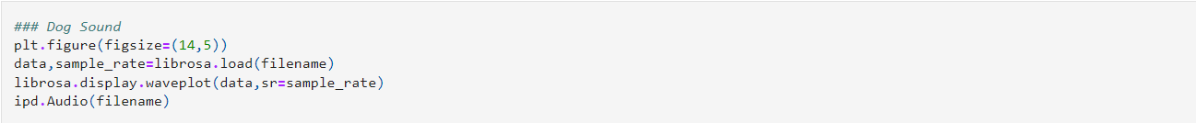
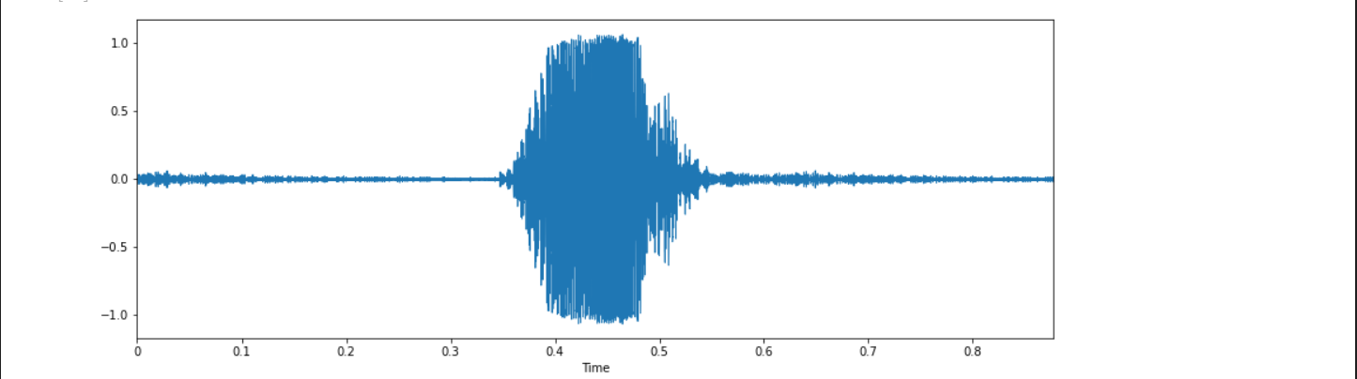
Exploratory Data Analysis(EDA)

Slide 12
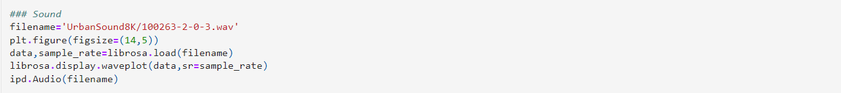
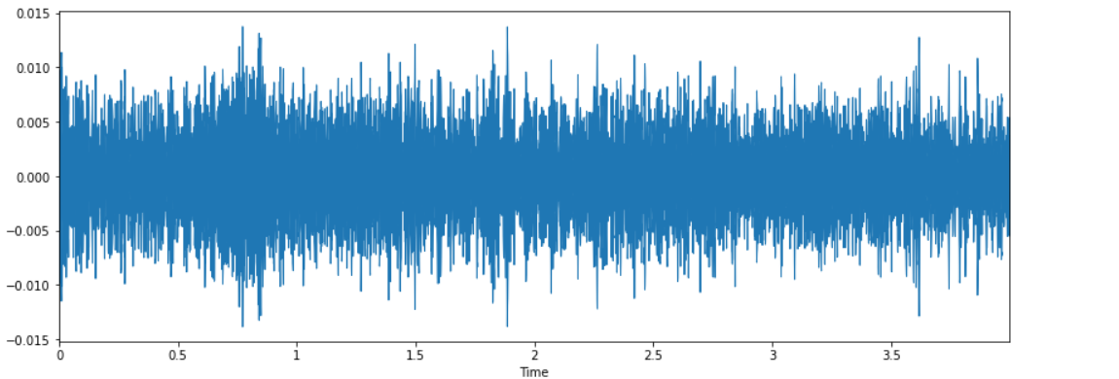
Exploratory Data Analysis(EDA)

Slide 13
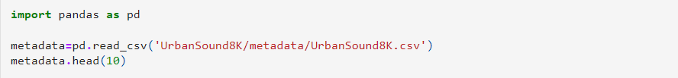
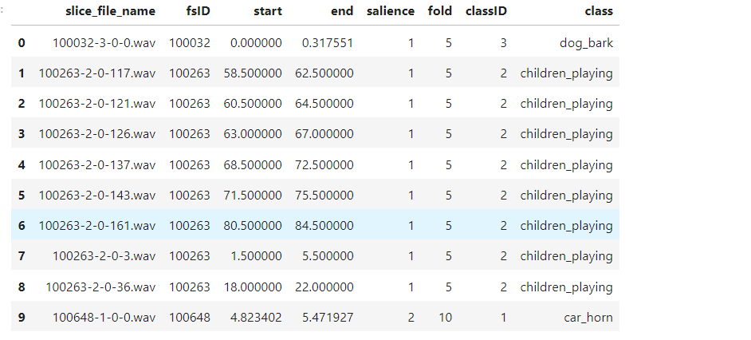
Exploratory Data Analysis(EDA)
To see my data I use metadata.

Slide 14
Audio Classification
Data processing
Preprocessing phase

Slide 15
Audio Classification Data processing
In this part we're going to explain deeply with librosa how to apply the classification :
First I'll read the sample by librosa -->1
Second I'll display the Audio data by using the print function and the data will be presented in one dimension because librose display the audio via mono (one signal) from –1 to 1
Let us see it in code:

Slide 16

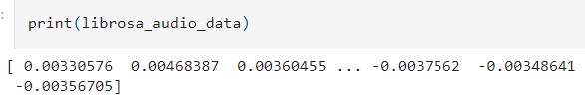
Read sample & display data
1- read
2-display

Slide 17
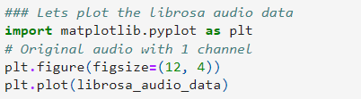
It's time to see the audio as a graph
We can do it by using matplotlib library and I'll use from it Pyplot and figure function to set the size for the figure , yeah I'll use plot too for displaying the data :

Slide 18
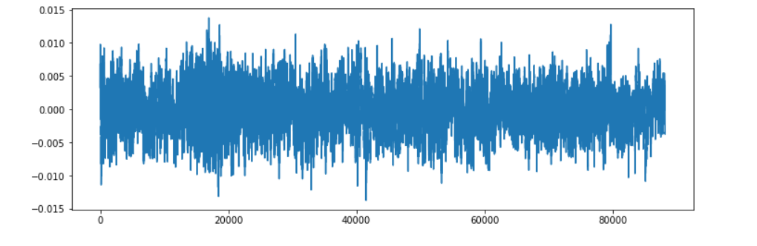
This is the graph :

Slide 19
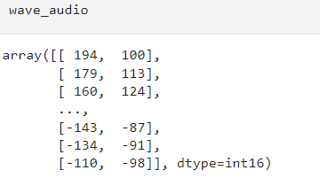
Lets read with scipy :
We're here will read the audio in 2 dimension and 2 channels :
How can I do the wave In 2D?

Slide 20
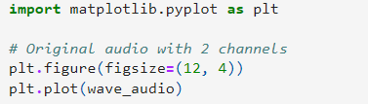
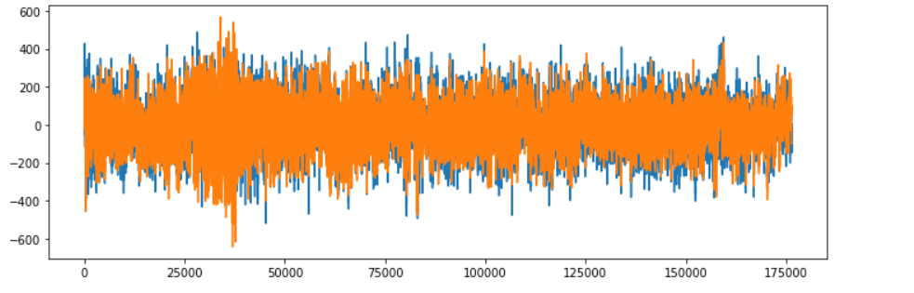
Let us see the graph
The graph above appeared in 2 dimensions because of the scipy the wave display in 2 channels and 2 waves .

Slide 21
MFCCS(Mel Frequency Cepstral Coefficients)
MFCCs were used to extract information from the audio signal, including information about the different frequencies present in the signal. They are useful in audio analysis because they mimic the way the human ear responds to sound.
Using MFCCs, the size of the audio data can be reduced and the quality of the algorithm used for audio classification can be improved. MFCCs can be used to recognize and classify different sounds into different categories, such as classifying audio with rhythm or audio with speech.

Slide 22
Extract Features
Here we will be using Mel-Frequency Cepstral Coefficients(MFCC) from the audio samples. The MFCC summarises the frequency distribution across the window size, so it is possible to analyse both the frequency and time characteristics of the sound. These audio representations will allow us to identify features for classification.
MFCCS take 2 things : data & sample rate
* sample rate mean how many times per second a sound is sampled --> 22050HZ

Slide 23
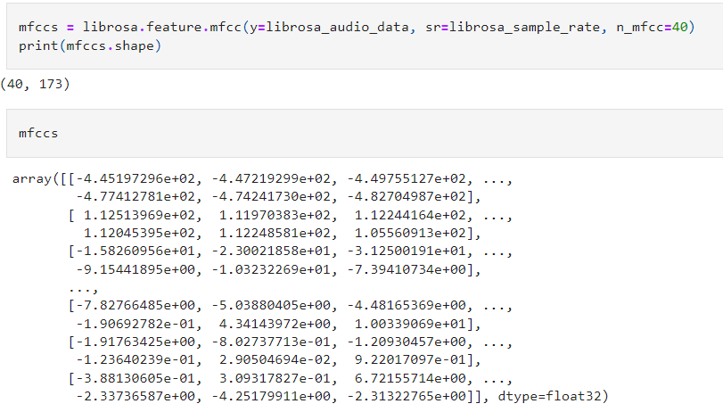
mfccs
Mfccs take 2 things data & sampling rate

Slide 24
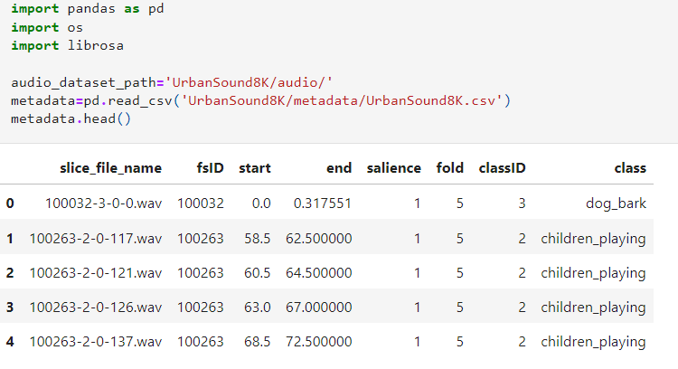
Extracting MFCC's For every audio file
import pandas , OS and librosa
This code to process the signal and the Frequency distribution via window size

Slide 25
Create a model with TensorFlow
Modeling phase

Slide 26
3-Modeling
To create a model we will use TensorFlow . TensorFlow is an end-to-end open source platform for machine learning. TensorFlow is a rich system for managing all aspects of a machine learning system; however, this class focuses on using a particular TensorFlow API to develop and train machine learning models.
First we will create Neural Network layers that contain three layers and output layer by using Dense().
Then we will make training and testing for our model.

Slide 27
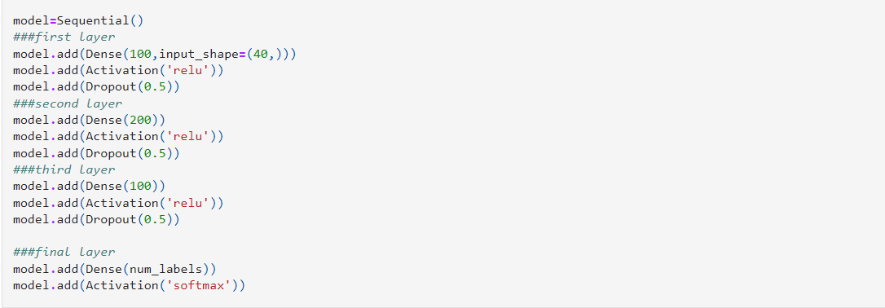
3-Modeling
Here we create a model with three layers :
these layers have 100 neurons , activation function type is relu and value of dropout is 0.5.
Output layer:
This layer has number of neurons equal to number of classes I have, activation function type is Softmax.
We use Softmax activation function because it is multiclass classification problem.

Slide 28
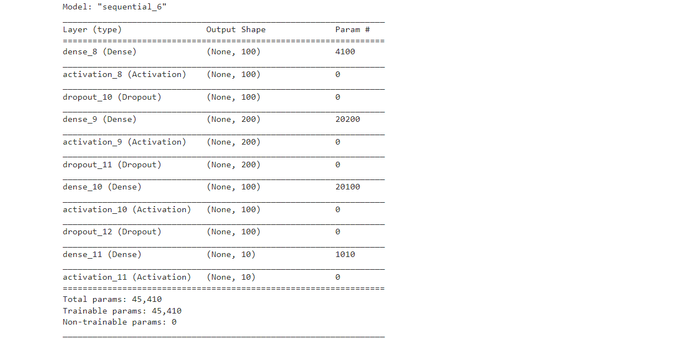
3-Modeling
To display a model we use :
This is our model
with 3 layers

Slide 29
3-Modeling
Then we will compile our model using loss , metrics and optimizer
Modeling
Training
testing

Slide 30
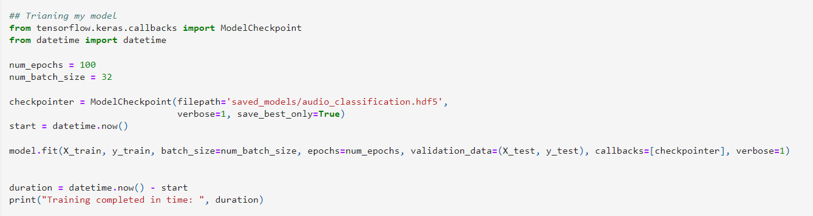
3-Modeling
1- Training the model:
We will train the model with
100 epochs and 32 batch size .
To save a model we use hdf5.

Slide 31
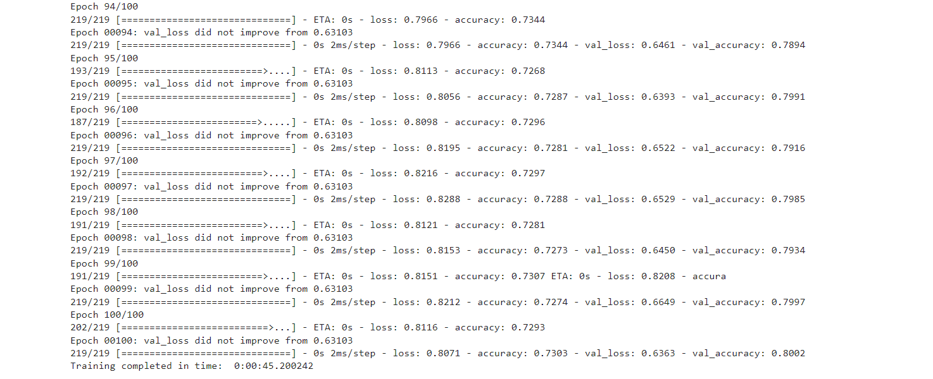
Training model

Slide 32

Training model
After this 100 epochs we get 80% accuracy.

Slide 33
2-Testing model
Steps of testing phase
Preprocess the new audio data
predict the classes
Inverse transform your Predicted Label

Slide 34
Testing Model:
1- The Model predict the label of test image.
2- Take the test label of each image that already have.
3- Compare between two values that model predict it and real label.
4- Calculate accuray of model.

Slide 35
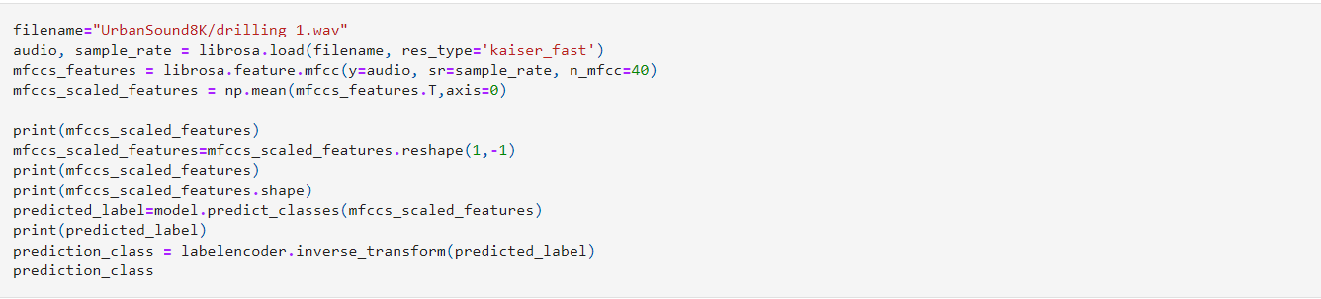
Testing model

Slide 36
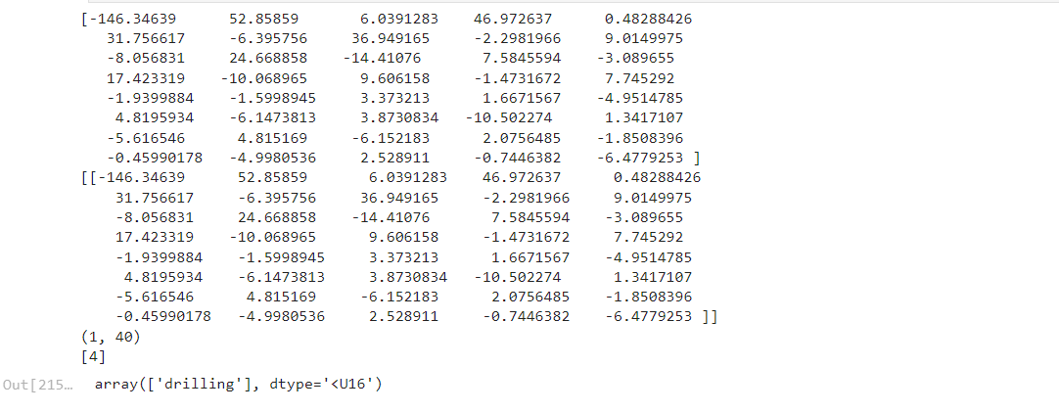
Result of testing a model

Slide 37


